Slide 1
Anti-Racist Pedagogy Series: Anti-Racist Course Design
July 14, 2020
Faculty Center for Ignatian Pedagogy

Slide 2
Acknowledgements
The Loyola community occupies the traditional homelands of the people of the Council of Three Fires, the Ojibwe, Potawatomi, and Odawa as well as the Menominee, Miami and Ho-Chunk nations. This was also a site of trade, travel, gathering and healing for more than a dozen other Native tribes and is still home to over 100,000 tribal members in the state of Illinois.
Thank you to our contributors:
Sasha Adkins
Susan Haarman
Kristin Krueger
Jon Schmidt
Frederick Staidum Jr
Thea Strand
Aana Vigen
Elizabeth (Liz) Webster

Slide 3
Session Agenda
Lay the groundwork for anti-racist course design
Give examples of anti-racist course design approaches
Make recommendations about designing anti-racist course materials
Give examples of anti-racist activities and assessments

Slide 4
Shared assumptions
We endeavor to move toward anti-racism in the classroom and as an institution.
We must listen to the experiences of others.
This session's content is applicable to any instructor, regardless of content you teach
This is the beginning. This is not a certification; we won’t leave as experts. We all have a lot to learn; this session is a piece of the start of the conversation and the work.
Notes:
Note about the series:
Start with ourselves and our experience
Ready ourselves to learn something new
No quick fix to racism! Cultivating the practice of reflection and action to create a more anti-racism classroom
This will be imperfect, this is not an answer to all of your questions
This is a start to the work we all need to do personally and in our teaching ans scholarship

Slide 5
Guidelines for Participation
Participation invited at different points throughout the session. You will be asked to use the chat or the raise hand feature. Currently, everyone is muted since we are such a large group.
Co-creating a safe learning environment with our peers
Session is being recorded and all of the materials will be shared on FCIP's website

Slide 6
Invitation for Reflection
Beginning from a place of Ignatian Indifference...
Regarding things only insofar as they bring you closer to God or the Common Good.
In other words, it’s the capacity to move away from what does not help me to work for justice or love others or connect to God—while staying engaged with what does.
What about my discipline, my research, my pedagogy, or my typical reactions might be something I should "regard with indifference" as I think about Anti-Racist course design?
Notes:
Note about the series:
Start with ourselves and our experience
Ready ourselves to learn something new
No quick fix to racism! Cultivating the practice of reflection and action to create a more anti-racism classroom
This will be imperfect, this is not an answer to all of your questions
This is a start to the work we all need to do personally and in our teaching ans scholarship

Slide 7
This process itself becomes a detour when we focus more on saying the right words than on addressing the root causes of injustice.
Notes:
(Sasha's slide)

Slide 8
Inward / Individual Work
&
Outward / Collective Work
Notes:
(Sasha's slide)
Breathe / push Watch night speech by Valerie Kaur 2017

Slide 9
"Racist" or "Anti-Racist"
is what we do, not who we are.
(a paraphrase of Ibram X. Kendi)
Notes:
(Sasha's slide) I will talk about definitions but this is what I people looking at while I do...

Slide 10
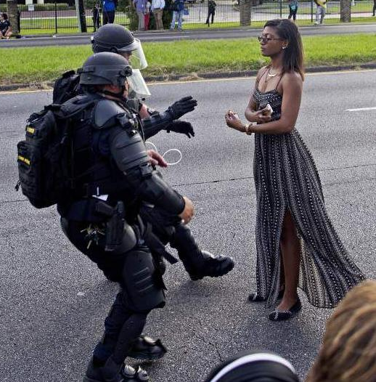
power
power
within
over
with
Which do we model in our classrooms?
Notes:
(Sasha's slide)
Ieshia Evans, Baton Rouge, 2016

Slide 11
Approaches to Course Design
Promoting more balanced power dynamics and environments
Sasha Adkins, PhD and MPH (Environmental Sustainability)
Frederick Staidum, PhD (English)
Elizabeth Webster, PhD (Criminal Justice and Criminology)

Slide 12
Universal Design Principle
Design for the 'least amongst us'
Do course policies, procedures, and practices make worse historical vulnerabilities of underrepresented and underserved student populations or create new ones? If so, how?
How can I intentionally mitigate, interrupt, and offset the vulnerabilities that have been and continue to be compounded by intersectionality?
How?
Consider the minutiae, even if it seems trivial to you.
Embrace flexibility.

Slide 13
Co-Creating Courses With Students, Not Just for Students
"Student choice days" in the syllabus
Self-selected homework assignments from a list of options (and students can propose their own projects)
Student-led discussion days to process the implications of what they are learning (ex: climate change and human health course)
Learning contracts & self-assessment
Notes:
(Sasha's slide)
Refer to decolonizing syllabus checklist

Slide 14
Re-thinking the "traditional" college student
Instructor Availability
Recognizing that first gen students may be reticent to ask for help
Reframe "office hours" as "student hours" or "drop-in hours"
Accommodating the working/ commuting student
Offer "zoom" meetings as an option for students to provide greater flexibility
Offer scheduled appointments

Slide 15
Language that Invites and Challenges
Courses are an opportunity to think critically about and challenge our uses of language.
Consider these policies:
As a course studying literature that sometimes explores the lived reality of racial, gendered, and sexual violence and marginalization, some texts may deploy derogatory slurs, such as “nigger,” “spic,” “faggot,” etc. These words retain their violent histories and meanings of uneven power relationships. As a result, we will not verbalize them nor their cognates during class discussion, but we are encouraged to discuss the author’s word choice (i.e., the why?) and its effect on literary meaning. When citing literary passages that include slurs within your writing, you should spell the word as originally published by the original author.
The singular form of “they” is very much acceptable in academic writing (e.g., when we do not know the gender of the author, the narrator, or a character; when we know that the author, the narrator, or a character is non-binary; OR when you are making a literary or historical argument that a narrator or character is non-binary).
Notes:
Whether the content of your course is about race or not; gender or not; sexuality or not; power or not...
as prominently as “conventional” policies, such as attendance, participation, deadlines, etc.
***Note about crossing disciplines*** specific disciplines may encounter essentializing language that is also problematic. For example, in CJ classes, we need to have a discussion about the terms "offender" "criminal" "felon" etc that we frequently encounter in readings but should avoid using in class. - Liz

Slide 16
Anti-Racist Learning Outcomes
Create Learning Outcomes that acknowledge and embrace the social and historical nature of knowledge production.
Humanities example: You will be able to interpret and evaluate literary works as complex representations of the beliefs, histories, economies, and power relations (i.e., politics) of the societies from which they are created.
Notes:
Regardless of discipline or content...
[This is one of the learning outcomes from my UCLR courses (Frederick). It is core requirement that is not stipulated to be “about race” by the University, but I justify this by grounding it in our mission and the fact that no knowledge is created within the vacuum. I think that this is related to the above point about Henrietta Lacks]

Slide 17
Learning Goals: You may or may not become a scientist, but one goal for this class to get you to think like one. It all begins with curiosity and with asking good questions. By the end of the semester, you will be able to formulate scholarly questions in the four domains:
• Descriptive (“what is going on?”)
• Explanatory (“why is it happening?”)
• Evaluative (“for whom is it a good or bad thing?”)
• Instrumental (“what can be done about it?”)
from https://jimproctor.us/envs/asking-environmental-questions/
Notes:
(Sasha's slide)
This is to show that even in science classes, we can talk about who is impacted and whose voices are given more weight, and what we can do to remedy the problems. I spend a week on “Who is a scientist” talking about intersectional identities and discrimination in science. We read Ben Barre’s essay “Does Gender Matter” about how his work was disparaged when he was a woman at MIT, but after he transitioned, he was praised for the same work (one professor who didn’t know he was the same person commented, “His work is so much better than his sister’s”...it gives the infamous quote from former president of Harvard Summers that women are not biologically equipped to be as good as men at science, and debunks, etc). Also highlight Max Liborion’s feminist decolonial science lab practices, we discuss people with disabilities who do science, etc. In small groups, students talk about their own positionality and whether they have been encouraged or discouraged from pursuing a career in science, and how they feel about that now that they reflect on it. We also talk about how society’s values influence which questions scientists investigate, which get funded, which studies get published, etc Also I encourage students who read other languages to find peer-reviewed articles in other languages, we talk about how the academy in the US pretends that only knowledge created in English counts. I find all this setting the stage really increases confidence and commitment from racialized students and others who never considered they could be scientists, or that science matters in a life devoted to social justice .

Slide 18
Anti-Racist Learning Outcomes
Social sciences example: You will explore how to work towards a social justice mission and confront inequality through your own professional path according to your career goals
Encourage students to "get proximate" through fieldwork
Invite professionals to share experiences of confronting inequality
Important Note: should be beneficial for both students and the community/ individual
Notes:
Regardless of discipline or content...
[This is one of the learning outcomes from my UCLR courses (Frederick). It is core requirement that is not stipulated to be “about race” by the University, but I justify this by grounding it in our mission and the fact that no knowledge is created within the vacuum. I think that this is related to the above point about Henrietta Lacks]

Slide 19
Approaches to Course Materials
Using an Anti-racist lens to think about what materials are required & selected for courses
Notes:
Approaches to course design that promote more balanced power
environments/dynamics policy re participation, next week we will dive in more. Today we will touch on: universal design principles, collaborating with students, instructor availability, grading, participation, class policies, and learning outcomes

Slide 20
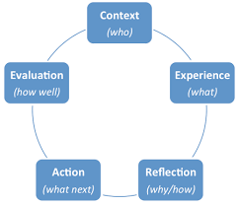
Beginning with the Question of Context
What is the context of my students?
What is the context of my subject matter, especially in this moment?
What is the context of the world, especially in this moment?
How can that be reflected in my course? How do I share this with students?
Notes:
Regardless of discipline or content...
[This is one of the learning outcomes from my UCLR courses (Frederick). It is core requirement that is not stipulated to be “about race” by the University, but I justify this by grounding it in our mission and the fact that no knowledge is created within the vacuum. I think that this is related to the above point about Henrietta Lacks]

Slide 21
Centering Marginalized Voices in Course
Representation Matters
Do an audit of your course for perspectives presented and images shown
Where can you include more diverse & underrepresented voice in a meaningful way?
Who has a stake in the issues or content being discussed? Are they present?
Are there other voices that have a place in the conversation beyond the usual?
Will these new voices play a significant role in what will be assessed?
More places for representation than you think
Articles, podcast, video, authors, thinkers, practitioners, exemplars, case studies, anecdotes, guest speakers, first person narratives, images in powerpoints...
Notes:
Regardless of discipline or content...
[This is one of the learning outcomes from my UCLR courses (Frederick). It is core requirement that is not stipulated to be “about race” by the University, but I justify this by grounding it in our mission and the fact that no knowledge is created within the vacuum. I think that this is related to the above point about Henrietta Lacks]

Slide 22
What about questions of Canon or 'Must Cover' material?
Canon vs. Classic
According to David Tracy
"Classic” is a text, event, or person that have a surplus of meaning, yet always resist definitive interpretation.
It claims authority because of the intensification of meaning and value that occurs in this work
It confronts us in our present horizon with the feeling that there is "something else"
Are there other Classics that have a place in your course alongside Period pieces or perspectives?
Is there a Classic from a BIPOC or POC voice that incorporates your learning goals?
What essential context needs to be given to elements of the Canon or Must Covers?
Notes:
But... Not as charity, not as savior, not as philanthropy... as that assumes deficiency. Instand as active work against systemic racism....
Over the next # slides, we will demonstrate how you might enact this principle, specifically how to: (1) embrace the fact that students of color and first generational students arrive to college with talents and abilities; (2) decenter and challenge our image of the so-called "traditional" college student; and (3) create policies and procedures that establishes an inclusive and anti-racist environment...

Slide 23
Types of Required Materials
Accessibility in Materials
Avoid requiring something cost prohibitive
Where possible, provide alternative access
Explore different modalities for materials (podcasts, videos, interviews, music)
Notes:
Regardless of discipline or content...
[This is one of the learning outcomes from my UCLR courses (Frederick). It is core requirement that is not stipulated to be “about race” by the University, but I justify this by grounding it in our mission and the fact that no knowledge is created within the vacuum. I think that this is related to the above point about Henrietta Lacks]

Slide 24
CHAT QUESTION
What element of the current context do you want to ensure is reflected / amplified in your class AND what specific course concept will you connect it to?
Notes:
Regardless of discipline or content...
[This is one of the learning outcomes from my UCLR courses (Frederick). It is core requirement that is not stipulated to be “about race” by the University, but I justify this by grounding it in our mission and the fact that no knowledge is created within the vacuum. I think that this is related to the above point about Henrietta Lacks]

Slide 25
THINGS WE DO:
Learning Activities & Assessment
Strategies that Foster Anti-Racism

Slide 26
Put together collaboratively by:
Kristin Krueger, PhD (Anthropology)
Thea Strand, PhD (Anthropology)
Aana Marie Vigen, PhD (Theology)
& Frederick Staidum, PhD (English)

Slide 27
BUILD IN FLEXIBILITY
Not everyone cannot perform their best in every format
Overall
Suggestions for Designing Activities & Assignments
AVOID CREATING DISPROPORTIONATE & UNDUE BURDENS
Does any assignment incur additional costs to students that are not stipulated in your syllabus?
INCORPORATE SUFFICIENT & VARIED OPPORTUNITIES FOR LOW/NO-STAKES CRITICAL SELF-REFLECTION
Examples: journaling, scribbles, anonymous responses to in-class surveys, polling, etc.

Slide 28
TAKE STEPS TO REDUCE
"STEREOTYPE THREATS"
Overall
Suggestions for Designing Activities & Assignments
Racialized students may experience
anxiety if they feel they are, in any way expected to confirm a "poor Black" or "poor immigrant" experience.
When/if they do, they may suffer in silence and/or ignore the assignment.
Never expect or ask individual students to "represent" their race (or other facet of their identity).
Black & Brown students in particular are already contending with many layers of assumptions, perceptions, and stereotypes by attending a predominately-white universityiety if they feel they are, in any way expected to confirm a "poor Black" or "poor immigrant" experience.
When/if they do, they may suffer in silence and/or ignore the assignment.
Never expect or ask individual students to "represent" their race (or other facet of their identity).
Black & Brown students in particular are already contending with many layers of assumptions, perceptions, and stereotypes by attending a predominately-white university.

Slide 29
Rethinking Assessment
A FEW THINGS TO CONSIDER

Slide 30
”As Americans, we not only see race but we hear it too” (Alim & Smitherman 2012, 25)
”Standard” English:
Non-neutral, positioned, power-laden
Implicated in White supremacy, slavery, colonization
“this is the oppressor’s language / yet I need it to talk to you” (Rich, hooks)
De-Privilege
“Standard American English”

Slide 31
Classroom discussion as a specific speech genre and acquired skill
Encourage non-"standard” voices, accents, ways of speaking, and the people and experiences they represent.
Do not mistake “standard” speech patterns for intelligence or aptitude.
Do not “correct” students’ speech.
Know that students may look/sound “actively engaged” in different ways.
In-Class
Participation

Slide 32
“Good writing” as genre-specific: What is the genre?
What are the learning objectives?
For content mastery, comprehension, reflection, connecting with materials: focus on WHAT is said, not HOW it is written.
Grade for grammar, mechanics, style only if teaching writing and providing support for writing development within the genre.
Writing

Slide 33
Questions that make sense to the instructor may not make sense to (all) students.
Avoid obscure vocabulary and unnecessarily complex syntax.
Analyze results carefully, look for uneven distributions, be open to adjustments.
Ask students for anonymous feedback.
Quizzes
& Exams

Slide 34
Classroom examples

Slide 35
The UnEssay
Daniel O'Donnell's website: http://people.uleth.ca/~daniel.odonnell/Teaching/the-unessay
WHY?
HOW?
GRADING?
Traditional essays are static, rigid, & rely on specific skillsets not acquired equally by all students.
Allows students to bring a unique & distinctive view to a topic/problem based on their lived experiences.
Students pick topic, medium, target audience
Is it compelling?
(complete, accurate, interesting)
Is it effective? (watchable/readable/viewable in an easy way)

Slide 36
Implicit & Explicit Bias
https://implicit.harvard.edu/implicit/takeatest.html
Implicit Bias
Explicit Bias
Explicit Bias
Students privately take the Harvard Implicit Bias test for Race. It has its criticisms, but is a good starting point.
Race-Stalking the Wild Taboo alt-right article
Find 5 ways human evolution/science are misconstrued.
Students AS A TEAM go through the article & references. Shows them they can de-construct an article's argument with their knowledge.

Slide 37
Scientific Racism
For the hard sciences - especially biology!
Development of Evolutionary Theory/Scientific Method
GENETICS, DNA, and/or CELLS
SCIENTIFIC RACISM
DECODING WATSON - 2nd half discusses James Watson & his racist comments on Africa. Pairs well with January 2019 NYT article by Amy Harmon.
THE IMMORTAL LIFE OF HENRIETTA LACKS
Video content warning: sexual assault. Read book chapters instead! - at LUC
THE LIFE AND TIMES OF SARA BAARTMAN - DVD at LUC

Slide 38
Racial Disparities in Healthcare
Jahi McMath
Maternal/Fetal Health
COVID-19
2013, California - "legal brain death" went against family's beliefs. New Yorker 2018 article by Rachel Aviv addresses racial & bioethical implications.
UNNATURAL CAUSES:
“When the Bough Breaks” - Chicago-focused, on Kanopy
Pairs well with 2018 NYT article by Linda Villarosa
& “In Sickness & in Wealth:” -- the social determinants of health
Data from Detroit, Milwaukee, Chicago, etc. by race shows this virus disproportionately affects people of color.

Slide 39
Aana’s take on Social Location
Human beings are situated in myriad social relationships & identities. These combinations affect our varied/distinct experiences, attitudes, assumptions, & beliefs (worldviews).
Individuals are often part of both dominant & subjugated identities/groups. Some identifications can be changed (widened, chosen); others are closer to an intrinsic part of who we are (e.g. genetics, family lottery, where you were born, innate attributes, etc.)
Social location matters regardless of our personal beliefs. Not everyone who is white believes X, yet systems/structures matter—how white people benefit from them. Beliefs alone have little to do with a person’s access to privilege, power, & to affect the decisions/policies of institutions.

Slide 40
“Draw Jesus”—
Theology, World History, Classical Studies, Honors…
“On the first day, we were given color pencils & asked to draw Jesus Christ. Most of us drew him with pale skin, blond hair, & blue eyes. The professor asked us to crumple up the images & explained how those could not have been Jesus’s physical features. He then explained to us the relationship between power & how history is produced to benefit those in power.”
For a World History to 1500 (first-year course).

Slide 41
Conversations across difference:
2 assignment options
On Healthcare:
Interview someone who is different from you in at least 4 different aspects of social location about that person's experience with healthcare.
On Social/Political Issues:
Have a conversation on a topic you both care about, but that you have different views & come at it from different social locations.

Slide 42
Social Location Activities & Resources
Anonymous Social Location Survey – early in the term
Later, define social location, report the anonymous results, & connect this informal survey to larger historical, racialized political, social, economic processes & realities.
Such as…

Slide 43
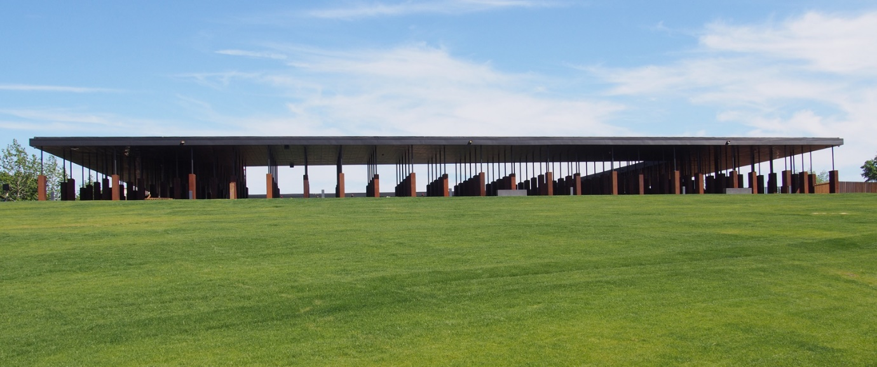
Unpack History of Jim Crow, Lynching & the Great Migration
The Lynching Memorial & Museum
Equal Justice Initiative
https://eji.org/

Slide 44
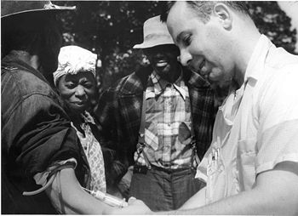
PHS Syphilis Study (1932-1972) https://www.cdc.gov/tuskegee/timeline.htm

Slide 45
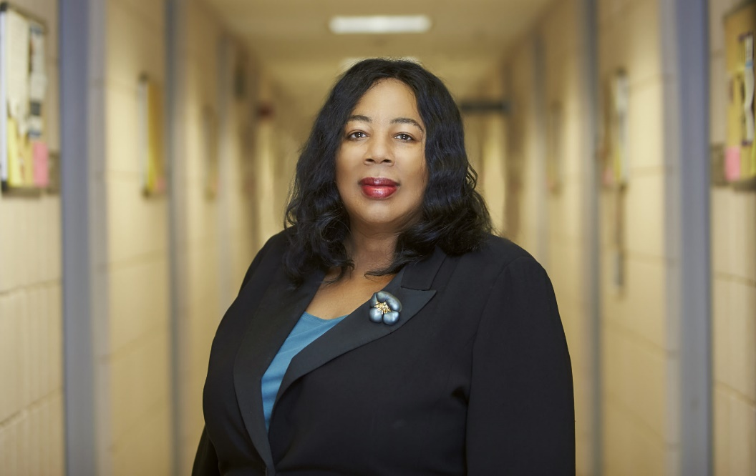
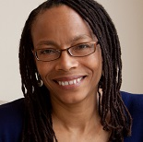

Slide 46
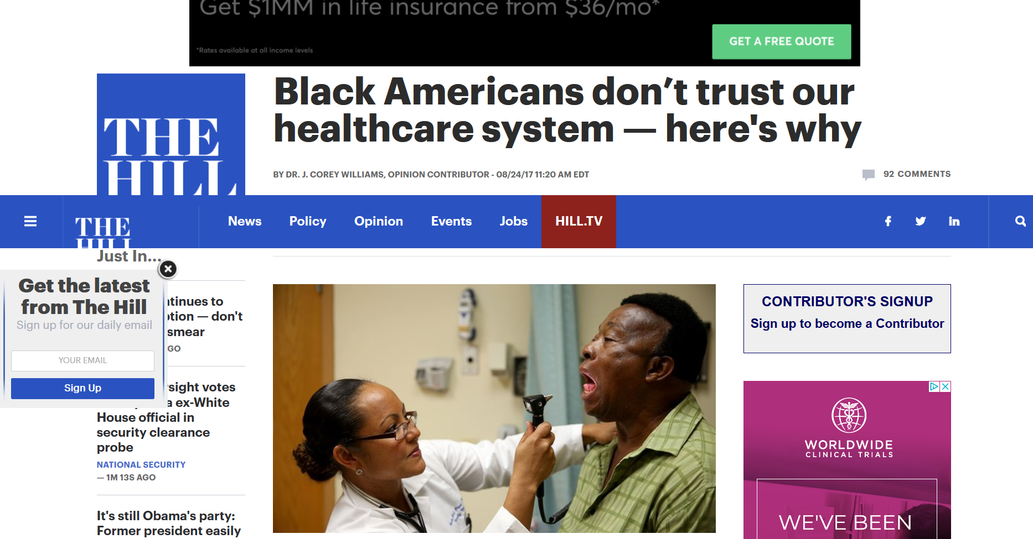
Unpack History of Jim Crow, Lynching & the Great Migratn

Slide 47
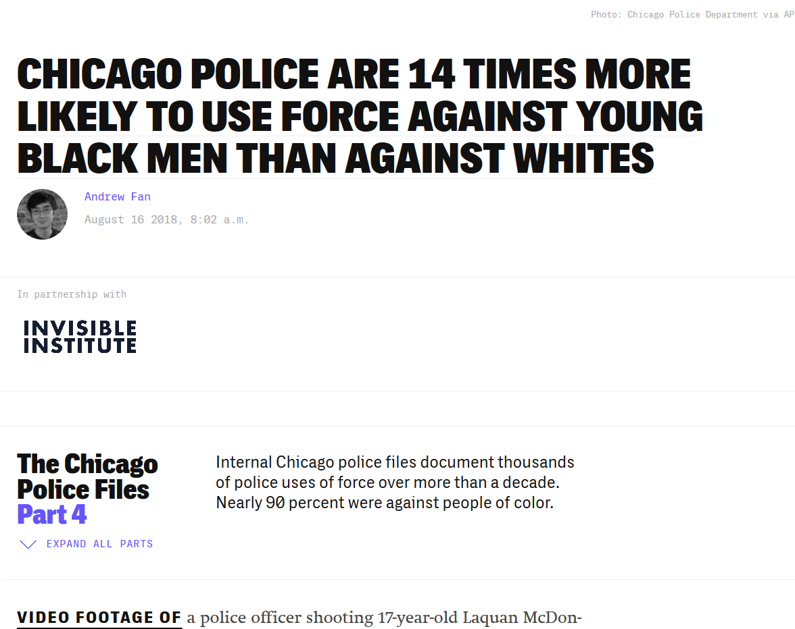
Unpack Policing
Statistics &
Examples
https://theintercept.com/2018/08/16/chicago-police-misconduct-racial-disparity/

Slide 48
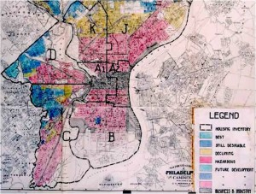
essdfsdf
Racial Redlining, Urban Renewal & Connections to Today

Slide 49
“Nationally, nearly two-thirds of neighborhoods deemed “hazardous” are inhabited by mostly minority residents, typically black and Latino, researchers found. Cities with more such neighborhoods have significantly greater economic inequality. On the flip side, 91 percent of areas classified as “best” in the 1930s remain middle-to-upper-income today, and 85 percent of them are still predominantly white.”
https://www.washingtonpost.com/news/wonk/wp/2018/03/28/redlining-was-banned-50-years-ago-its-still-hurting-minorities-today/

Slide 50
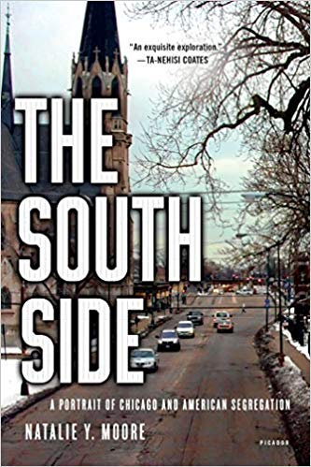
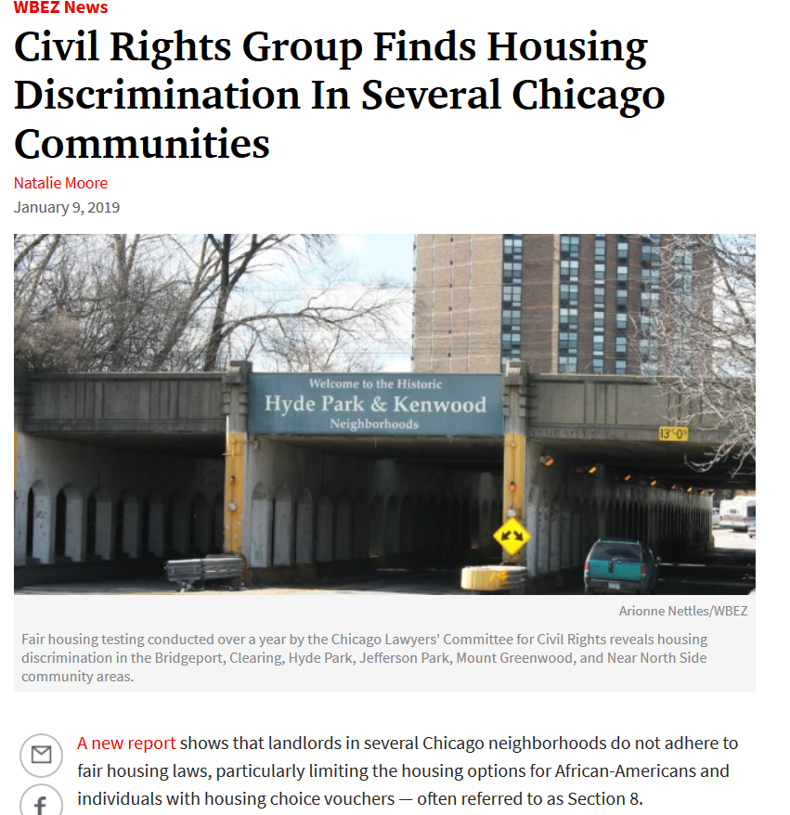
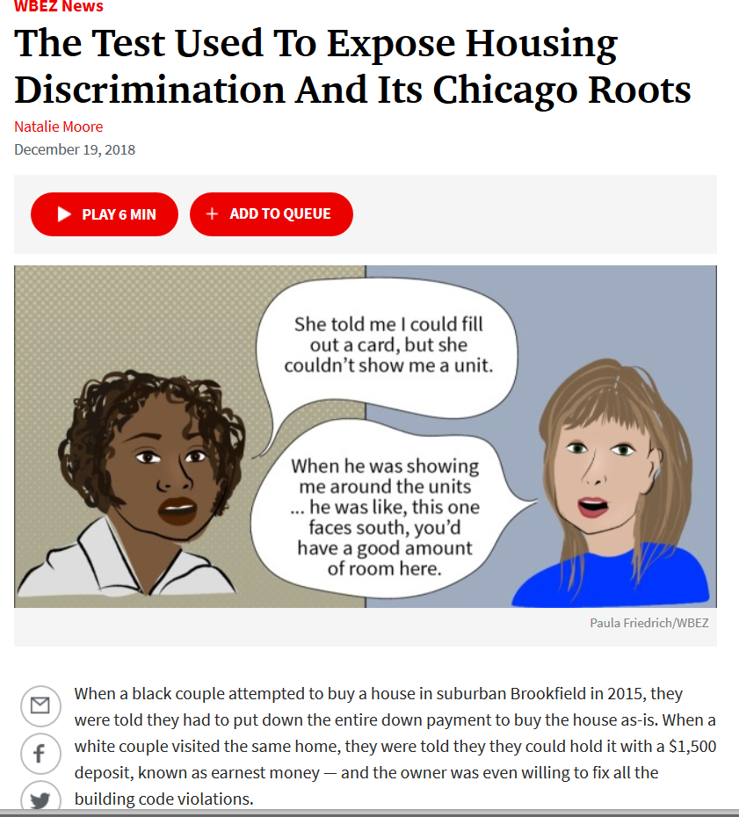
es
https://www.wbez.org/shows/wbez-news/civil-rights-group-finds-housing-discrimination-in-several-chicago-communities/45b03806-dafe-42dc-96e5-74aa3039fb9b
https://www.wbez.org/shows/wbez-news/the-test-used-to-expose-housing-discrimination-and-its-chicago-roots/5c44b3ac-562c-455f-946d-0453098555ed

Slide 51
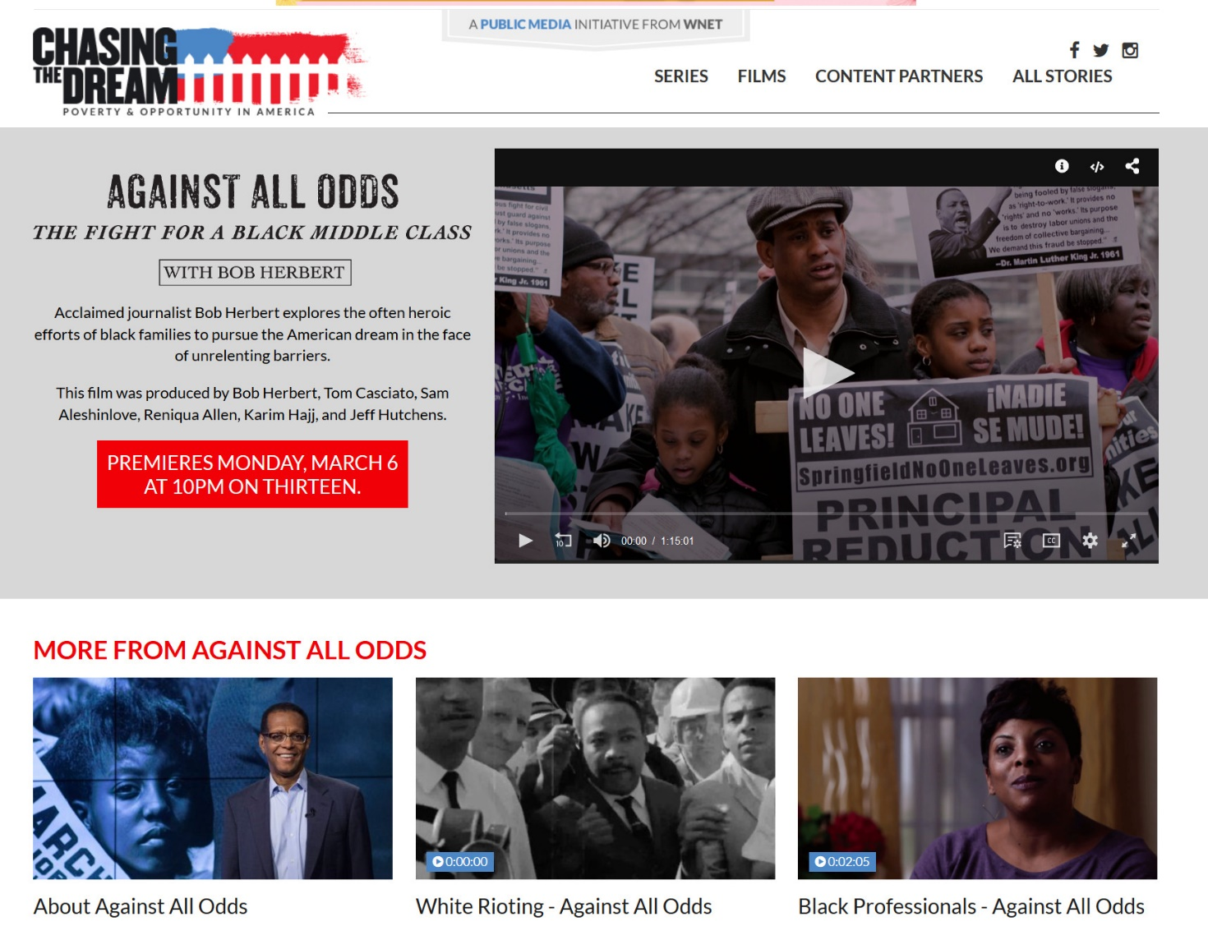
3-part documentary series:
“The Difference Between Us”
“The Story We Tell”
“The House We live In”
https://www.pbs.org/race/000_General/000_00-Home.htm &
https://www.racepowerofanillusion.org/
https://www.pbs.org/wnet/chasing-the-dream/films/against-all-odds/

Slide 52
Questions?
We have some time left over for discussion

Slide 53
Evaluation
FCIP and the presenters appreciate your feedback. We will use it to inform the remaining sessions.

